Slide 1
Android: WebView Browser
Chapter(16)

Slide 2
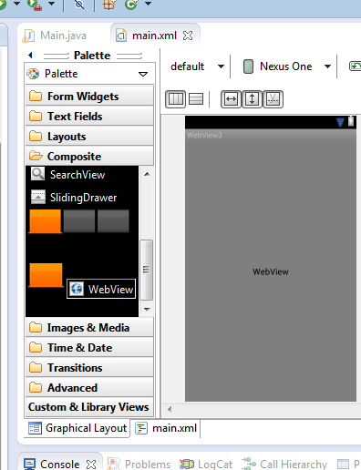
WebView Browser
Android provides a built-in Web browser UI control called WebView.
WebView is used for displaying local HTML material or browsing Internet pages.
The Android browser is based on WebKit, the same engine that powers Apple's Safari Web browser.
Applications using the WebView widget must request INTERNET permission.
2

Slide 3
WebView Browser
The browser will try to access the Internet through
WiFi services,
cellular network,
reverse tethering,
any other technology available.
The WebKit engine includes methods to
navigate forward and backward through a history record,
zoom in and out,
perform text searches,
load data
stop loading and
more…
3

Slide 4
WebView Browser
Warning !!!
In order for your Activity to access the Internet you must add the INTERNET permission to your Android Manifest file:
(see next example)
<manifest xmlns:android="http://schemas.android.com/apk/res/android"
package="com.example.webview_url"
android:versionCode="1"
android:versionName="1.0" >
<uses-sdk
android:minSdkVersion="8"
android:targetSdkVersion="15" />
<uses-permission android:name="android.permission.INTERNET"/>
<application
android:icon="@drawable/ic_launcher"
android:label="@string/app_name"
android:theme="@style/AppTheme" >
<activity
android:name=".MainActivity"
android:label="@string/title_activity_main" >
<intent-filter>
<action android:name="android.intent.action.MAIN" />
<category android:name="android.intent.category.LAUNCHER" />
</intent-filter>
</activity>
</application>
</manifest>
4

Slide 5
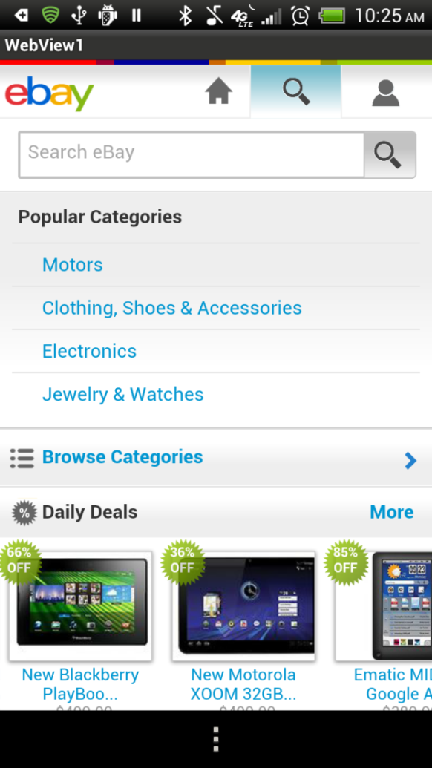
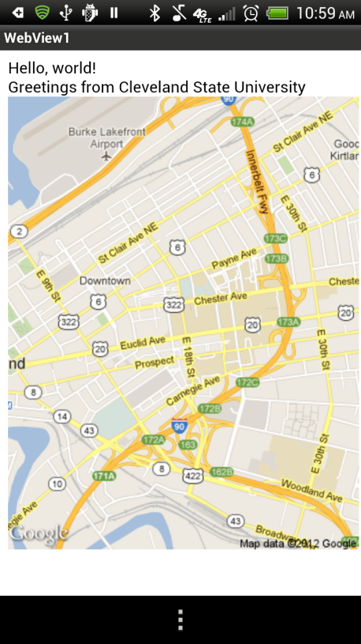
WebView Browser
Example 1A: A simple browsing experience
This example uses a WebView widget to
Reach a particular URL (eBay)
Load a local HTML page in which the
user instructs Google Maps to show
a static map around given coordinates.
Reference:
http://developer.android.com/guide/webapps/webview.html
5

Slide 6

WebView Browser
Example 1A: A simple browsing experience
Example 2 - Let’s go e-shopping
<?xml version="1.0" encoding="utf-8"?>
<LinearLayout xmlns:android="http://schemas.android.com/apk/res/android"
android:orientation="vertical"
android:layout_width="match_parent"
android:layout_height="match_parent"
>
<WebView
android:id="@+id/webkit"
android:layout_width="match_parent"
android:layout_height="match_parent"
/>
</LinearLayout>
6

Slide 7
WebView Browser
Example 1A: A simple browsing experience
(1) Let’s go e-shopping (2) Visiting Cleveland State U.
public void onCreate(Bundle savedInstanceState) {
super.onCreate(savedInstanceState);
setContentView(R.layout.activity_main);
browser = (WebView) findViewById(R.id.webkit);
browser.getSettings().setJavaScriptEnabled(true); // allow scripts
browser.setWebViewClient(new WebViewClient() ); // page navigation
// Try version 1 or 2 (please, one at the time!!!)
// Version 1.---------------------------------------------------
// provide an URL to some web page outside of the app
browser.loadUrl("http://www.eBay.com");
// Version 2. -------------------------------------------------------
// code your htlm in-line page (or store page in "/assets" or SD card)
// we show a static Google map centered on CSU
// showMyHomeMadeHtmlPage();
}// onCreate
This app is
hard-wired to eBay
1
2
7

Slide 8
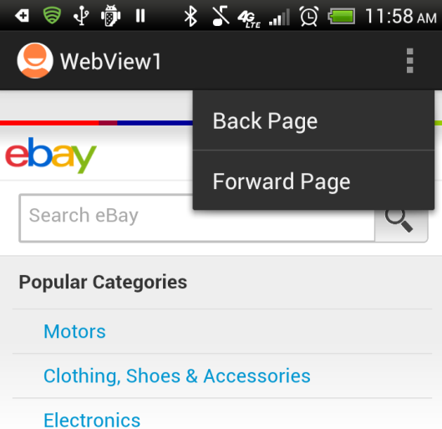
WebView Browser
Example 1A: A simple browsing experience
Part 1 - Let’s go Back & For
// /////////////////////////////////////////////////////////////
// browser navigation implemented through the menu
@Override
public boolean onCreateOptionsMenu(Menu menu) {
getMenuInflater().inflate(R.menu.activity_main, menu);
return true;
}// onCreateOptionsMenu
@Override
public boolean onOptionsItemSelected(MenuItem item) {
String option = item.getTitle().toString();
if (option.equals("Forward Page"))
browser.goForward();
if (option.equals("Back Page"))
browser.goBack();
return true;
}//onOptionsItemSelected
}// class
8

Slide 9
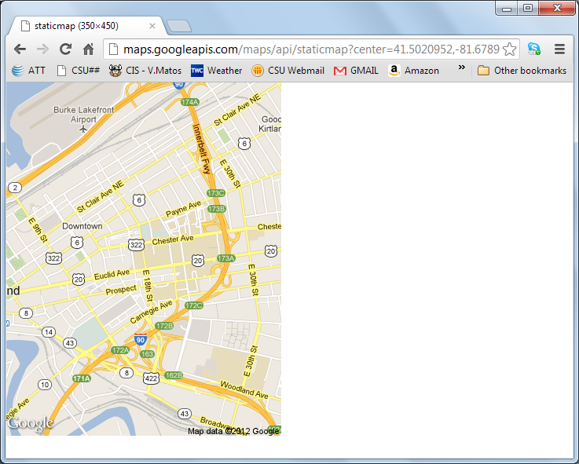
WebView Browser
Example 1A: A simple browsing experience
Part 2 - Let’s visit CSU
Playing with Google Maps: Use your computer to access the following link
http://maps.googleapis.com/maps/api/staticmap?center=41.5020952,-81.6789717&zoom=14&size=350x450&sensor=false
It displays a web page showing
a static map centered around the
the given coordinates (latitude
and longitude of Cleveland
State University Student’s center)
We want to reproduce this
behavior in our Android app.
9
9

Slide 10
WebView Browser
Example 1A: A simple browsing experience
Part 2 - Let’s visit CSU (add this method to the app)
private void showMyHomeMadeHtmlPage() {
String aGoogleMapImage =
"<img src=\"http://maps.googleapis.com/maps/api/"
+ "staticmap?center=41.5020952,81.6789717&"
+ "zoom=14&size=350x450&sensor=false\"> ";
String myLocalHtmlPage =
"<html> " + "<body> Hello, world! "
+ "<br> Greetings from Cleveland State University"
+ aGoogleMapImage
+ "</body> "
+ "</html>";
browser.loadData( myLocalHtmlPage, "text/html", "UTF-8“ );
}
10

Slide 11
WebView Browser
Warning
Your Android application must explicitly enable the javaScript code of visited pages to operate .
By default WebViews have Javascript is turned off
To activate scripts do this:
browser.setSettings().setJavaScriptEnabled(true);
11

Slide 12
WebView Browser
Warning
To open links clicked by the user (History Record ), provide a WebViewClient for your WebView
In our example:
WebView browser = (WebView) findViewById(R.id.webview);
browser.setWebViewClient( new WebViewClient() );
12

Slide 13
WebView Browser
Browser Commands
There is no navigation toolbar with the WebView widget (saving space).
You could supply the UI –such as a Menu– to execute the following operations:
reload() to refresh the currently-viewed Web page
goBack() to go back one step in the browser history, and canGoBack() to determine if there is any history to trace back
goForward() to go forward one step in the browser history, and canGoForward() to determine if there is any history to go forward to
goBackOrForward() to go backwards or forwards in the browser history, where negative/positive numbers represent a count of steps to go
canGoBackOrForward() to see if the browser can go backwards or forwards the stated number of steps (following the same positive/negative convention as goBackOrForward())
clearCache() to clear the browser resource cache and clearHistory() to clear the browsing history
13

Slide 14
WebView Browser
Using our running example:
browser.goBack();
browser.goForward();
browser.goBackOrForward(-2);
browser.goBackOrForward(+2);
browser.canGoBack();
browser.canGoForward();
browser.canGoBackOrForward(-2);
browser.canGoBackOrForward(+2);
browser.clearCache(true);
browser.clearHistory();
browser.stopLoading();
14

Slide 15
WebView Browser
Why it is important to allow JavaScript in WebView?
Using javaScript in a WebView has several important consequences:
Visited pages powered by javaScript become functional and operate as their designers expected them to be.
You could create Android applications whose User-Interface is designed in HTML.
Java custom-made exchange objects could be created to mediate data exchange between the hosting Android application and its locally stored set of HTML pages (powered by JavaScript).
15

Slide 16
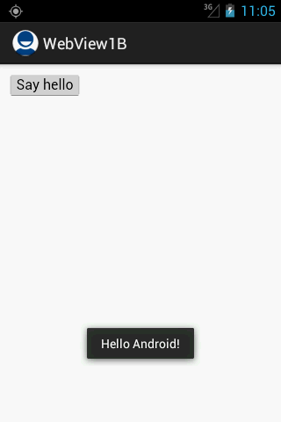
WebView Browser
Example 1B: JavaScripting
This app has two pieces; one is a ‘local’ HTML page, the other a typical Android app.
Android loads the HTML page into a WebView and waits for the user to operate on the page (It contains a button)
When the user clicks the (html) button, a javaScript method is called. The method sends to Android a piece of html data which is shown in an Android Toast view.
HTML Button
Message received and displayed by Android
Reference: http://developer.android.com/guide/webapps/webview.html
16

Slide 17
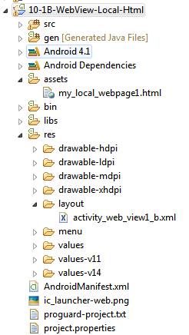
WebView Browser
Example 1B: JavaScripting
<html>
<input type="button"
value="Say hello"
onClick="showAndroidToast(
'Hello Android!')" />
<script type="text/javascript">
function showAndroidToast(toast) {
Android.showToast(toast);
}
</script>
</html>
assets/my_local_webpage1.html
This local page is stored in the /assets folder. It declares an HTML <input> button
and its onClick handler.
17

Slide 18
WebView Browser
Example 1B: JavaScripting
The Android app defines a WebView control to host HTML pages
<RelativeLayout xmlns:android="http://schemas.android.com/apk/res/android"
xmlns:tools="http://schemas.android.com/tools"
android:layout_width="match_parent"
android:layout_height="match_parent" >
<WebView
android:id="@+id/webView1"
android:layout_width="match_parent"
android:layout_height="match_parent"
android:layout_alignParentLeft="true" />
</RelativeLayout>
18

Slide 19
WebView Browser
Example 1B: JavaScripting
An interface object is attached to the WebView. It will allow the Android app and the HTML page to ‘talk’ to each other.
public class WebView1B extends Activity {
@Override
public void onCreate(Bundle savedInstanceState) {
super.onCreate(savedInstanceState);
setContentView(R.layout.activity_web_view1_b);
WebView browser = (WebView) findViewById(R.id.webView1);
browser.getSettings().setJavaScriptEnabled(true);
browser.addJavascriptInterface(new JavaScriptInterface(this), "AndroidInterface");
// if the html file is in the app's memory space use:
browser.loadUrl("file:///android_asset/my_local_webpage1.html");
// if the file is in the app's SD card use:
// browser.loadUrl("file:///sdcard/my_local_webpage1.html");
// CAUTION: Manifest must include
// <uses-permission android:name="android.permission.INTERNET"/>
// <uses-permission android:name="android.permission.READ_EXTERNAL_STORAGE"/>
}//onCreate
}//class
19

Slide 20
WebView Browser
Example 1B: JavaScripting
The method showToast() will be invoked by a javaScript onClick handler defined in the HTML page, in addition the event will supply data for the toastMsg string
public class JavaScriptInterface {
Context mContext;
/** Instantiate the interface and set the context */
JavaScriptInterface(Context c) {
mContext = c;
}
/** Show a toast from the web page */
public void showToast(String toastMsg) {
Toast.makeText(mContext, toast, Toast.LENGTH_SHORT).show();
}
}
HTML supplied data
20

Slide 21
WebView Browser
Example 1B: JavaScripting
You need to request Internet permission for accessing pages outside of your app space. If you local HTML pages are stored in the SD card you also need permission to read the device.
<manifest xmlns:android="http://schemas.android.com/apk/res/android"
package="com.example.webview_local_html"
android:versionCode="1" android:versionName="1.0" >
<uses-sdk
android:minSdkVersion="8"
android:targetSdkVersion="15" />
<uses-permission android:name="android.permission.INTERNET"/>
<uses-permission android:name="android.permission.READ_EXTERNAL_STORAGE"/>
<application
android:icon="@drawable/ic_launcher"
android:label="@string/app_name"
android:theme="@style/AppTheme" >
<activity
android:name=".WebView1B"
android:label="@string/title_activity_web_view1_b" >
<intent-filter>
<action android:name="android.intent.action.MAIN" />
<category android:name="android.intent.category.LAUNCHER" />
</intent-filter>
</activity>
</application>
</manifest>
21

Slide 22

WebView Browser
Combining HTML + JAVASCRIPT + ANDROID
Advantages offered by Android Development
Access to native services on the device, including location services
Placement in the Android Market
Rapid development using the Android SDK and Eclipse.
Advantages offered by Google Maps API
Application exists in a server not inside a device.
Rapid versioning, removing the requirement for your users to download and install constant updates.
More frequent feature additions and bug fixes from Google.
Cross-platform compatibility: Using the Maps API allows you to create a single map that runs on multiple platforms.
Designed to load fast on Android and iPhone devices.
22

Slide 23
WebView Browser
Combining HTML + JAVASCRIPT + ANDROID
Learning Strategy
WebView2: Passing complex objects between Android and JS
(goal: create interconnectivity)
WebView3: Mapping a fixed location using Google Maps V3
(Pure HTML + JS, just update the server -no need to upgrade ALL devices carrying the application, portability, homogeneous design)
WebView4: Passing a real location object to JS – draw a map centered at given location (mapping current location, combines two above).
23

Slide 24

WebView Browser
HTML + JAVASCRIPT + ANDROID
Example 2: Exchanging objects between Android & JS
The app consists of an Android Activity and an HTML page holding JS scripts.
The user will interact with the app through the commanding HTML page.
A complex interface object will be created by the Android side of the app.
The object will include methods to pass data/actions from Android-to-HTML, and HTML-to-Android
HTML
Page
Android OS
Complex
Interface
Object
24

Slide 25
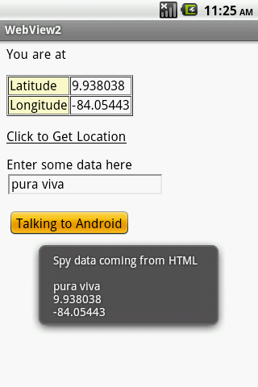

WebView Browser
HTML + JAVASCRIPT + ANDROID
Example 2: Exchanging objects between Android & JS
HTML
Android OS
locater object
The methods in this object are made public
so JavaScript code can invoke them
( class variables are not visible)
25
25

Slide 26
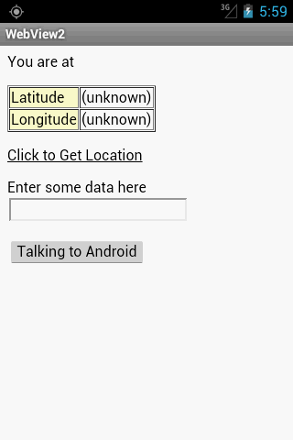
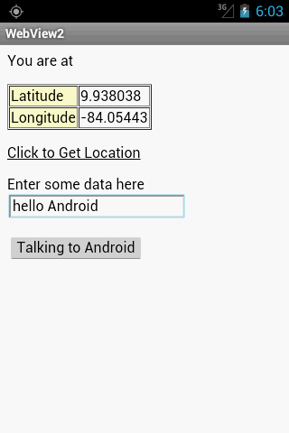
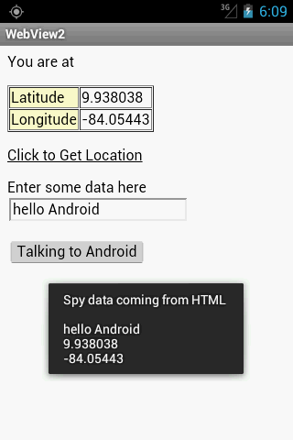
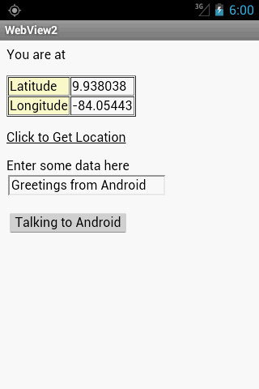
WebView Browser
Example 2. Passing Objects between Android and JS
26

Slide 27
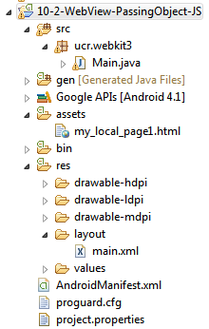
WebView Browser
Example 2. Passing Objects between Android and JS
Putting the pieces together:
Place a WebView in the main.xml file
Place html page in the assets folder
Create the Java object to share with JS
<?xml version="1.0" encoding="utf-8"?>
<LinearLayout
xmlns:android="http://schemas.android.com/apk/res/android"
android:orientation="horizontal"
android:layout_width="fill_parent"
android:layout_height="fill_parent">
<WebView
android:id="@+id/webview"
android:layout_width="fill_parent"
android:layout_height="fill_parent"/>
</LinearLayout>
27

Slide 28
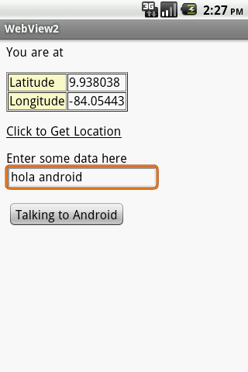
WebView Browser
Example 2.
HTML Page (1 of 2) Passing Objects between Android and JS
<!DOCTYPE HTML PUBLIC "-//W3C//DTD HTML 4.01 Transitional//EN">
<html>
<head>
<title>Android GeoWebOne Demo</title>
<script language="javascript">
function whereami() {
// html asks android to provide data using object's GET methods
document.getElementById("lat").innerHTML=locater.getLatitude();
document.getElementById("lon").innerHTML=locater.getLongitude();
document.getElementById("myText").value = locater.getCommonData();
}
function talkBack2Android() {
// bridge object used to send local (html) data to android app
locater.setCommonData("Greetings from html");
var spyHtml = "Spy data coming from HTML\n"
+ "\n" + document.getElementById("myText").value
+ "\n" + document.getElementById("lat").innerHTML
+ "\n" + document.getElementById("lon").innerHTML;
locater.htmlPassing2Android(spyHtml);
}
</script>
</head>
28

Slide 29
WebView Browser
Example 2.
HTML Page (2 of 2) Passing Objects between Android and JS
<body>
<p>You are at</p>
<table border="1" cellspacing="1" cellpadding="1">
<tr>
<td bgcolor="#FFFFCC"> Latitude </td>
<td> <span id="lat"> (unknown) </span></td>
</tr>
<tr>
<td bgcolor="#FFFFCC"> Longitude </td>
<td> <span id="lon"> (unknown) </span></td>
</tr>
</table>
<p><a onClick="whereami()" ><u>Click to Get Location</u></a></p>
<p> Enter some data here <input type="text" id="myText" />
<p> <input type="button"
onclick= "talkBack2Android()"
onclick= "talkBack2Android()"
value="Talking to Android">
</body>
</html>
29

Slide 30
WebView Browser
Example 2. Passing Objects between Android and JS
public class Main extends Activity {
WebView browser;
MyLocater locater = new MyLocater();
Location mostRecentLocation;
@Override
public void onCreate(Bundle icicle) {
super.onCreate(icicle);
setContentView(R.layout.main);
// get a location fix (lat, lon)
mostRecentLocation = fakeGetLocation();
// set up the webview to show location results
browser = (WebView) findViewById(R.id.webview);
browser.getSettings().setJavaScriptEnabled(true);
browser.addJavascriptInterface(locater, "locater");
browser.loadUrl("file:///android_asset/my_local_page1.html");
}//onCreate
30

Slide 31
WebView Browser
Example 2. Passing Objects between Android and JS
private Location fakeGetLocation() {
// faking the obtaining of a location object (discussed later!)
Location fake = new Location("fake");
fake.setLatitude(9.938038);
fake.setLongitude(-84.054430);
return fake;
}
// "MyLocater" is used to pass data back and forth between
// Android and JS code-behind
public class MyLocater {
private String commonData = "XYZ";
public double getLatitude() {
if (mostRecentLocation == null) return (0);
else return mostRecentLocation.getLatitude();
}
public double getLongitude() {
if (mostRecentLocation == null) return (0);
else return mostRecentLocation.getLongitude();
}
31

Slide 32
WebView Browser
Example 2. Passing Objects between Android and JS
public void htmlPassing2Android(String dataFromHtml) {
Toast.makeText(getApplicationContext(),
"1\n" + commonData, 1).show();
commonData = dataFromHtml;
Toast.makeText(getApplicationContext(),
"2\n" + commonData, 1).show();
}
public String getCommonData(){
return commonData;
}
public void setCommonData(String actualData){
commonData = actualData;
}
}//MyLocater
}//class
32

Slide 33
WebView Browser
Example 3. Using Google JavaScript Maps API V3
The Google Maps Javascript API is a free service that lets you embed Google Maps in your own web pages.
It is especially designed to be faster and more applicable to mobile devices (as well as traditional desktop browser applications)
The API provides a number of utilities for manipulating maps (just like on the
http://maps.google.com web page) and adding content to the map through a variety of services, allowing you to create robust maps applications on your website/app.
Link: https://developers.google.com/maps/documentation/javascript/
33

Slide 34
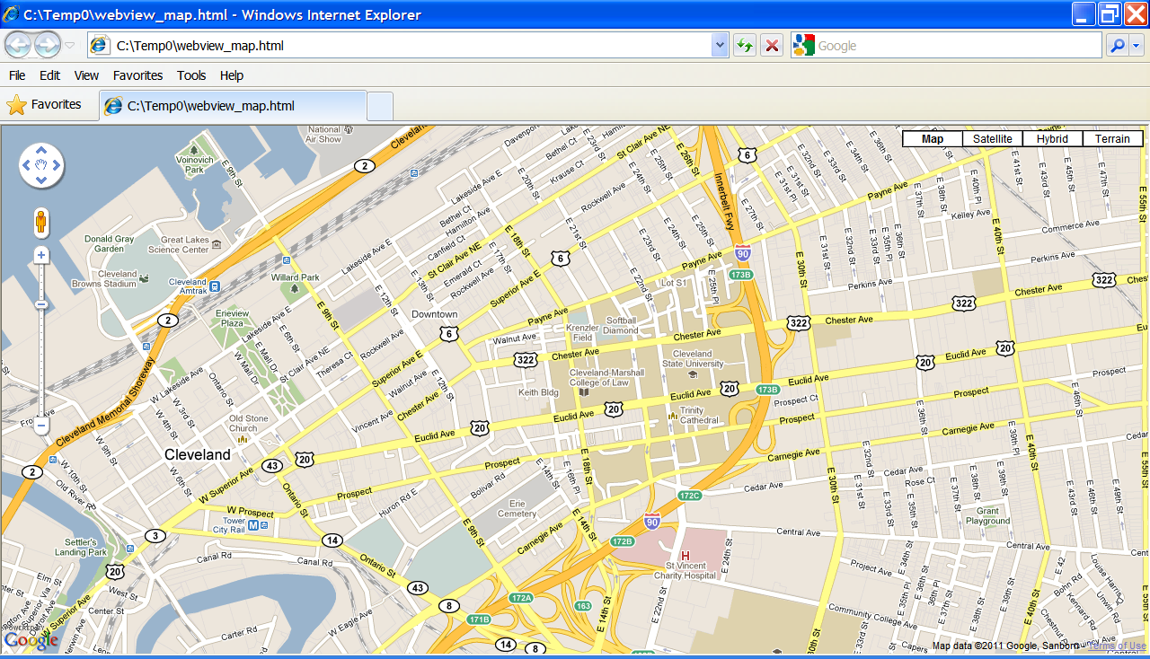
WebView Browser
Example 3. Using Google JavaScript Maps API V3
A Google map centered around “Cleveland State University, Ohio”
(seeing here with IExplorer on Windows machine)
34
Link: http://code.google.com/apis/maps/documentation/javascript/basics.html

Slide 35
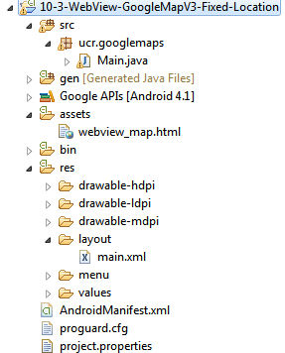
WebView Browser
Example 3. Using Google JavaScript Maps API V3
Putting the pieces together:
Place a WebView in the main.xml file
Place html page in the assets folder
Add permission requests to manifest
Connect to Java code
<?xml version="1.0" encoding="utf-8"?>
<LinearLayout
xmlns:android="http://schemas.android.com/apk/res/android"
android:orientation="horizontal"
android:layout_width="fill_parent"
android:layout_height="fill_parent">
<WebView
android:id="@+id/webview"
android:layout_width="fill_parent"
android:layout_height="fill_parent"/>
</LinearLayout>
35
35

Slide 36
WebView Browser
Example 3. Using Google JavaScript Maps API V3 1 of 2
<!DOCTYPE html>
<html>
<head>
<meta name="viewport" content="initial-scale=1.0, user-scalable=no" />
<style type="text/css">
html { height: 100% }
body { height: 100%; margin: 0px; padding: 0px }
#map_canvas { height: 100% }
</style>
<script type="text/javascript"
src="http://maps.google.com/maps/api/js?sensor=false">
</script>
<script type="text/javascript">
function initialize() {
var latlng = new google.maps.LatLng(41.5020952, -81.6789717);
var myOptions = { zoom: 15,
center: latlng,
mapTypeId: google.maps.MapTypeId.ROADMAP };
var map = new google.maps.Map( document.getElementById("map_canvas"),
myOptions );
}
</script>
</head>
This is the HTML page: webview_map.html
36

Slide 37
WebView Browser
Example 3. Using Google JavaScript Maps API V3 2 of 2
<body onload="initialize()">
<div id="map_canvas" style="width:100%; height:100%"></div>
</body>
</html>
This is the HTML page: webview_map.html
37

Slide 38
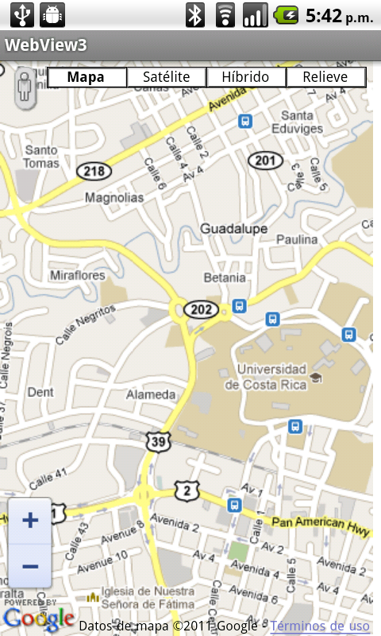
WebView Browser
Example 3. Using Google JavaScript Maps API V3
Add the following permission requests to the AndroidManifest.xml file
<uses-permission android:name="android.permission.INTERNET"/>
<uses-permission android:name="android.permission.ACCESS_COARSE_LOCATION" />
<uses-permission android:name="android.permission.ACCESS_FINE_LOCATION" />
Map image shown on an Android device
38

Slide 39
WebView Browser
Example 3. Using Google JavaScript Maps API V3
public class WebView4 extends Activity {
WebView browser;
@Override
public void onCreate(Bundle savedInstanceState) {
super.onCreate(savedInstanceState);
setContentView(R.layout.main);
// connect browser to local html file showing map
browser = (WebView) findViewById(R.id.webview);
browser.getSettings().setJavaScriptEnabled(true);
browser.loadUrl("file:///android_asset/webview_map.html");
}
}
39

Slide 40
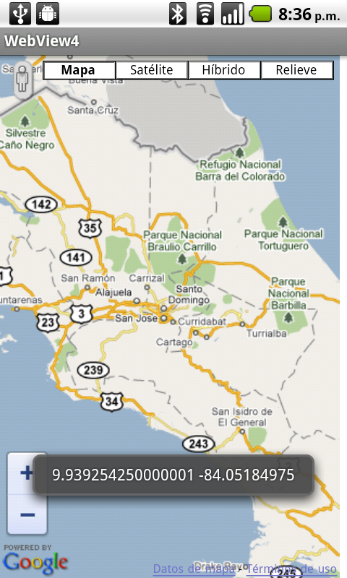
WebView Browser
Delay until Service Lesson
Example4. Using Google JavaScript Maps API V3 (real locations)
This experience combines the two previous examples:
The goal is to use an Android object to pass ‘real location’ data to an html webpage.
The page contains a JavaScript fragment to draw a map centered on the given coordinates.
Latitude and longitude detected by the device.
Image taken from an Android phone.
40
Warning: Make sure your target is: Google APIs (API Level 8) or higher.

Slide 41
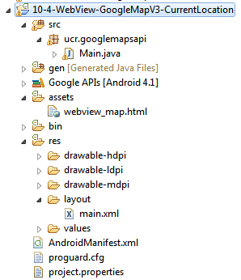
WebView Browser
Example 4. Using Google JavaScript Maps API V3 (real locations)
Putting the pieces together:
Place a WebView in the main.xml file
Place html page in the assets folder
Add permission requests to manifest
Connect to Java code
<?xml version="1.0" encoding="utf-8"?>
<LinearLayout
xmlns:android="http://schemas.android.com/apk/res/android"
android:orientation="horizontal"
android:layout_width="fill_parent"
android:layout_height="fill_parent">
<WebView
android:id="@+id/webview"
android:layout_width="fill_parent"
android:layout_height="fill_parent"/>
</LinearLayout>
41
41

Slide 42
WebView Browser
This HTML page creates a map using ‘real’ coordinates passed inside the ‘locater’ object
Example 4. assets/webview_map.html
<!DOCTYPE html>
<html>
<head> <meta name="viewport" content="initial-scale=1.0, user-scalable=no" />
<meta http-equiv="content-type" content="text/html; charset=UTF-8"/>
<title>Google Maps JavaScript API v3 Example4: Marker Simple</title>
<style type="text/css">
html { height: 100% }
body { height: 100%; margin: 0px; padding: 0px }
#map_canvas { height: 100% }
</style>
<script type="text/javascript" src="http://maps.google.com/maps/api/js?sensor=false"></script>
<script type="text/javascript">
function initialize() {
//var myLatlng = new google.maps.LatLng(41.5020952, -81.6789717); //CSU coordinates
var myLatlng = new google.maps.LatLng(locater.getLatitude(), locater.getLongitude());
var myOptions = { zoom: 17,
center: myLatlng,
mapTypeId: google.maps.MapTypeId.ROADMAP
}
var map = new google.maps.Map(document.getElementById("map_canvas"), myOptions);
var marker = new google.maps.Marker( { position: myLatlng, map: map });
}
</script>
</head>
<body onload="initialize()">
<div id="map_canvas"></div>
</body>
</html>
42

Slide 43
WebView Browser
Example4. Main Activity Android & Google Map V3 App (real locations)
public class Main extends Activity implements LocationListener {
private WebView browser;
LocationManager locationManager;
MyLocater locater = new MyLocater();
@Override
protected void onDestroy() {
super.onDestroy();
// cut location service requests
locationManager.removeUpdates(this);
}
private void getLocation() {
locationManager = (LocationManager)
getSystemService(Context.LOCATION_SERVICE);
Criteria criteria = new Criteria();
criteria.setAccuracy(Criteria.ACCURACY_FINE); // use GPS device
//criteria.setAccuracy(Criteria.ACCURACY_COARSE); // towers, wifi
String provider = locationManager.getBestProvider(criteria, true);
// In order to make sure the device is getting the location, request
// updates [wakeup after changes of: 5 sec. or 10 meter]
locationManager.requestLocationUpdates(provider, 5, 10, this);
locater.setNewLocation(locationManager.getLastKnownLocation(provider));
}
43

Slide 44
WebView Browser
Example4. Main Activity Android & Google Map V3 App (real locations)
@Override
public void onCreate(Bundle savedInstanceState) {
super.onCreate(savedInstanceState);
setContentView(R.layout.main);
getLocation();
setupBrowser();
this.setRequestedOrientation(ActivityInfo.SCREEN_ORIENTATION_PORTRAIT);
}//onCreate
/** Set up the browser object and load the page's URL **/
@SuppressLint("SetJavaScriptEnabled")
private void setupBrowser() {
final String centerMapURL = "javascript:centerAt("
+ locater.getLatitude() + ","
+ locater.getLongitude() + ")";
// set up the browser to show location results
browser = (WebView) findViewById(R.id.webview);
browser.getSettings().setJavaScriptEnabled(true);
browser.addJavascriptInterface(locater, "locater");
browser.loadUrl("file:///android_asset/webview_map.html");
// Wait for the page to load then send the location information
browser.setWebViewClient(new WebViewClient() {
@Override
public void onPageFinished(WebView view, String url) {
browser.loadUrl(centerMapURL);
}
});
} //setupBrowser
44

Slide 45
WebView Browser
Example4. Main Activity Android & Google Map V3 App (real locations)
@Override
public void onLocationChanged(Location location) {
String lat = String.valueOf(location.getLatitude());
String lon = String.valueOf(location.getLongitude());
Toast.makeText(getApplicationContext(), lat + "\n" + lon, 1).show();
locater.setNewLocation(location);
}
@Override
public void onProviderDisabled(String provider) {
// needed by Interface. Not used
}
@Override
public void onProviderEnabled(String provider) {
// needed by Interface. Not used
}
@Override
public void onStatusChanged(String provider, int status, Bundle extras) {
// needed by Interface. Not used
}
45

Slide 46
WebView Browser
Example4. Main Activity Android & Google Map V3 App (real locations)
// ///////////////////////////////////////////////////////////////////
// An object of type "MyLocater" will be used to pass data back and
// forth between the Android app and the JS code behind the html page.
// ///////////////////////////////////////////////////////////////////
public class MyLocater {
private Location mostRecentLocation;
public void setNewLocation(Location newCoordinates){
mostRecentLocation = newCoordinates;
}
public double getLatitude() {
if (mostRecentLocation == null) return (0);
else return mostRecentLocation.getLatitude();
}
public double getLongitude() {
if (mostRecentLocation == null) return (0);
else return mostRecentLocation.getLongitude();
}
}// MyLocater
}//class
46

Slide 47
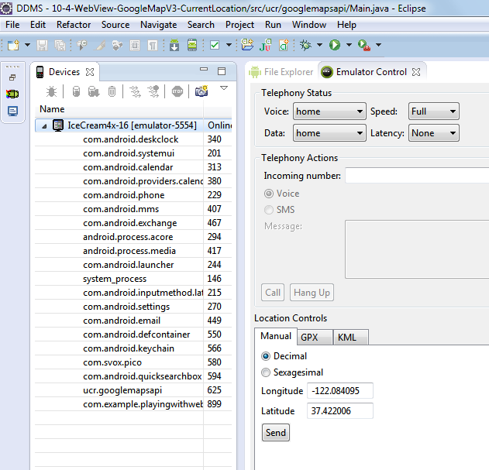
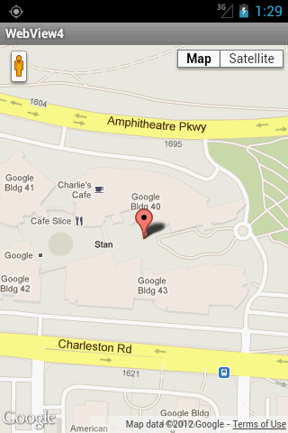
WebView Browser
Example4. Main Activity Android & Google Map V3 App (real locations)
Testing the app using the Emulator Control Panel
47

Slide 48
WebView Browser
Where to go next?
Google Maps Developers Documentation
https://developers.google.com/maps/documentation/
Google Maps API – Webservices
http://code.google.com/apis/maps/documentation/webservices/index.html
Google Maps JavaScript API V3
http://code.google.com/apis/maps/documentation/javascript/tutorial.html
Questions ?
48
48

